Slide 1
Context-Aware Intrusion Response in Smart Grids: Integrating Explainable AI with Physics-Informed Graph RAG
Presented by:
Jiakai Tang
jiakai.tang@mail.utoronto.ca
ECE MEng Student
March 26, 2026

Slide 2
Agenda
Problem Statement
Proposed Approach
Evaluation Metric – CPAS
Experiment Methodology
  Data sources
  Evaluation approach
Appendix
  Research Trends and Recent Development
  Knowledge base material
  LLM-as-a-judge instruction script for CPAS components

Slide 3
Problem Statement – the semantic gap between IDS and XAI outputs and cyber physics reality
While the integration of deep learning Intrusion Detection Systems (IDS) and Explainable AI (XAI) has advanced the identification of cyber threats in critical infrastructure, current XAI methodologies remain ”context-blind."
When an anomaly is detected, standard XAI tools output network-level statistical deviations rather than mapping the threat to physical grid constraints or topological realities. This creates a severe semantic gap: operators are provided with mathematically dense, cyber-centric alerts that lack actionable, physical context.
As such, there is a critical need for a dynamic framework capable of translating raw XAI features into physics-grounded, role-specific mitigation strategies to reduce cognitive load and prevent cascading physical failures during active intrusions.

Slide 4
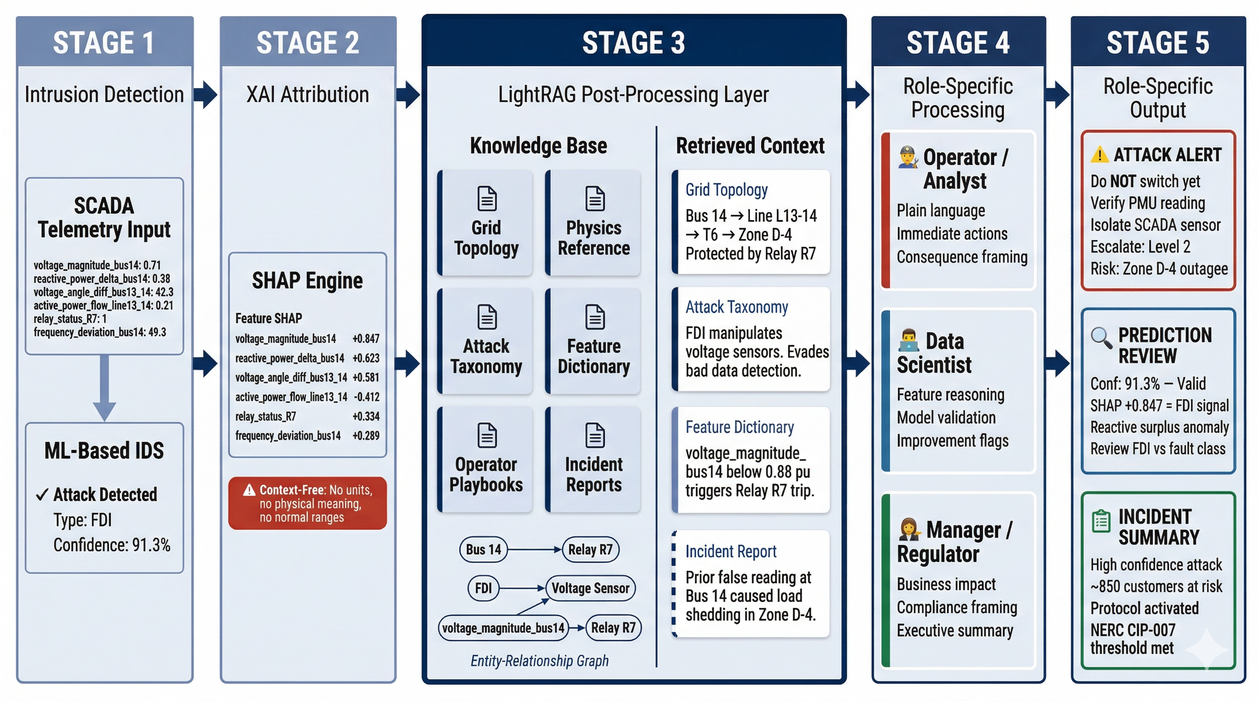
XAI Augmented CPA Detection with GraphRAG-based Role-specific Decision Support

Slide 5
Advantages of this approach
Model and XAI Agnostic Architecture
Graph-Based Domain Knowledge Grounding
Role Differentiated Information Presentation
Post-processing layer decouples decision support from model architecture — any IDS model and any XAI technique produces operationally grounded outputs without retraining or pipeline redesign. A replicable pipeline demonstrating human-centred explainability — no modification to existing IDS architecture, no retraining, no expert translation required.
RAG mitigates the hallucination from LLM and LightRAG encodes grid topology, physics, and operational knowledge as an entity-relationship graph — enabling relational consequence reasoning beyond what flat vector similarity search can achieve.
One post processing contextualizer layer produces distinct outputs calibrated to operator urgency, analyst rigour, and regulatory compliance needs. Easily implementable through prompt engineering or skills implementation.

Slide 6
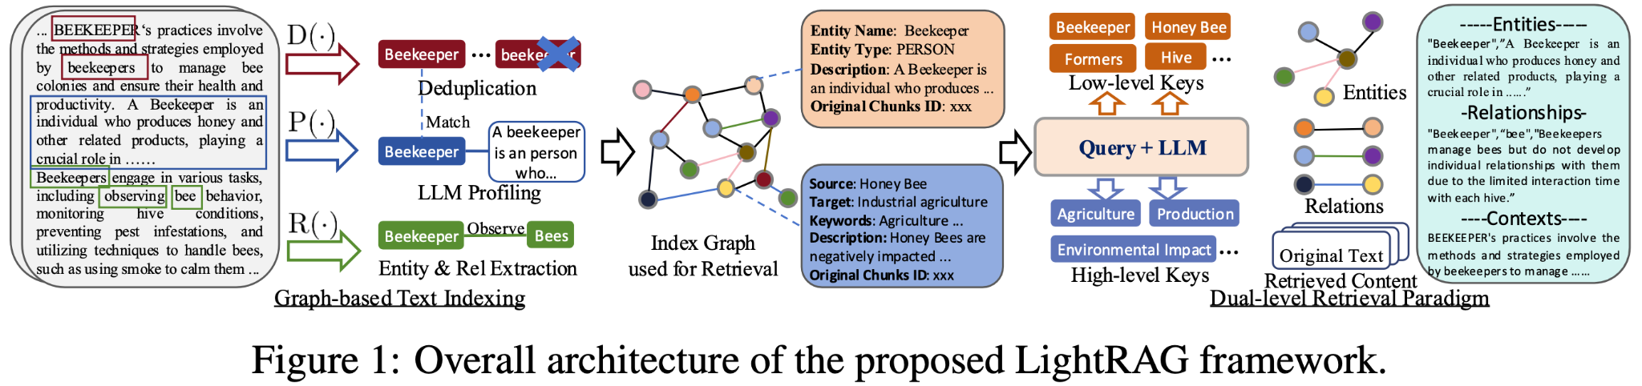
Advantages of this approach – continued
Source: https://lightrag.github.io/

Slide 7
CPAS — A Novel Evaluation Metric for Decision Support Quality
Cyber-Physical Actionability Score (CPAS) has been proposed and defined mathematically as:
D (Domain Grounding): Accuracy of the present-state root cause within the user's specific domain
C (Cascading Impact): Accuracy of the forecasted downstream trajectory based on the user's area of concern.
A (Actionability): Clarity and executability of the suggested intervention.
R (Role Resonance): Adherence to the user's native vocabulary and formatting.
H (Hallucination Detection): A binary penalty(H = 0 or 1) triggering the severe deduction if domain-specific assets or policies are invented.
w (Weights): Tunable parameters.

Slide 8
Experiment Design

Slide 9
Experiment design
What We Evaluate
How We Evaluate
What We Expect
Baseline
IDS output only
Raw prediction + confidence score
No XAI, no context
1
Generate outputs for 20–30 test scenarios covering multiple attack types and all three role personas
Primary Finding
Full system CPAS > IDS+XAI CPAS > Baseline CPAS across all roles
2
Feed each output to LLM judge with CPAS rubric and knowledge base summary as reference context
Current State
IDS + XAI
Raw SHAP feature attribution added
Still context-free
Secondary Finding
Role Alignment (R) improves most dramatically with routing layer added
3
Collect per-dimension scores A, P, R, C and binary H flag for each output
Proposed System
IDS + XAI + LightRAG
Role-specific grounded output
Full post-processing pipeline
Additional experiment
Hallucination rate lower in GraphRAG system (like LightRAG) versus ordinary RAG and naïve LLM baseline
4
Compute CPAS score per condition per role and aggregate across all scenarios

Slide 10
Data sources
IDS & XAI TRAINING DATASET
Dataset | Traffic data | Attack Types Covered | Access
A dataset to train intrusion detection systems based on machine learning models for electrical substations | IEC104 & IEC61850 | DoS (IEC104 only), Packet flooding, Fuzzing, Packet starvation (IEC104 only), NTP DoS (IEC104 only), PTP attack (IEC61850 only), Port scanning (IEC104 only), PitM (IEC104 only), Replay (IEC61850 only) | Public
KNOWLEDGE BASE DOCUMENTS
Priority | Document Type | References | CPAS Impact
1 | Grid Topology | IEEE 14-bus, MATPOWER | P, C
2 | Physics Reference | Glover & Sarma, IEEE Std | P, C
3 | Attack Taxonomy | MITRE ATT&CK ICS, NIST | A, C
4 | Feature Dictionary | Custom model design | All dimensions
5 | Operator Playbooks | NERC CIP, ENTSO-E | A, R
6 | Equipment Manuals | GE, SEL, ABB public docs | P, R
7 | Incident Reports | NERC Events, DOE OE-417 | C, P
8 | ML Model Docs | Model Cards framework | R
All knowledge base content is synthetic, generated from open standards and public references only.

Slide 11
Appendix

Slide 12
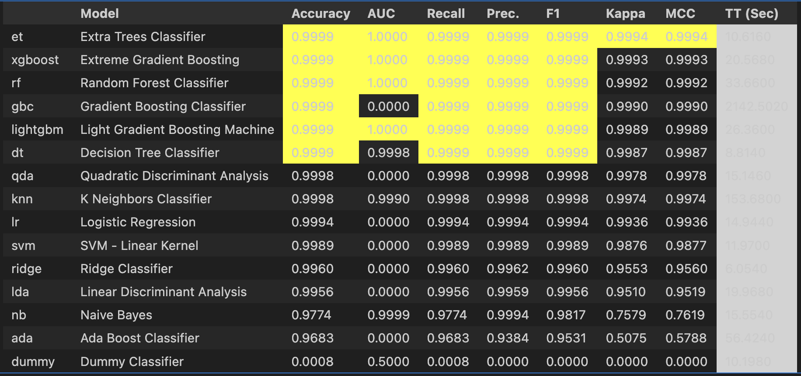
Benchmark
Results from IDS models

Slide 13
Research trends and recent development
Paper Title | Link | Publisher / Year | Key Results & Innovations | Limitations (The Case for LightRAG)
Cyber threat intelligence for smart grids using knowledge graphs, digital twins, and hybrid machine learning in SCADA networks | Link | Journal of Engineering (2026) | Uses directed-graph algorithms to create digital twins, visualizing the physical effects of False Data Injection Attacks (FDIA) on SCADA networks. | Static Topologies: Digital twins and traditional DiGraphs require massive computational effort to rebuild when grid topology changes (e.g., a breaker trips). LightRAG’s incremental update capability is required to ingest live grid state changes without re-indexing the entire twin.
Artificial Intelligence and Physics-Based Anomaly Detection in the Smart Grid: A Survey | Link | IEEE Xplore (2025) | Establishes the necessity of physics-based anomaly detection to catch cyber-attacks aimed at physical disruption. | High Latency / Computation: Hardcoding differential equations or physical laws into the detection model itself slows down real-time inference. LightRAG allows the detection model to remain fast, moving the physics-checking to an asynchronous, highly efficient post-processing retrieval step.
Natural Language Processing (NLP)-Based Frameworks for Cyber Threat Intelligence in Industry 4.0 | Link | MDPI (2026) | Pairs fast ML for intrusion detection with LLMs to generate operator-friendly explanations of the threat. | Token Cost & Context Loss: Naive RAG frameworks chunk text, destroying the spatial relationships of the grid. Standard GraphRAG solves this but at a massive token/API cost. LightRAG’s dual-level retrieval provides both entity-level (the specific relay) and concept-level (the attack type) context at a fraction of the cost.
CyKG-RAG: Towards knowledge-graph enhanced retrieval augmented generation for cybersecurity | Link | ISWC (2024) | Integrates Knowledge Graphs with standard RAG to retain critical topological attack patterns for cybersecurity contexts. | Sub-optimal Retrieval Breadth: Traditional GraphRAG struggles to efficiently summarize broad, systemic issues (like multi-substation concept drift) without pulling the entire graph into the prompt. LightRAG’s high-level retrieval paradigm isolates these strategic insights specifically for the Data Scientist persona without overwhelming the context window.
Explainable AI-Based Intrusion Detection Systems for Industry 5.0 and Adversarial XAI: A Systematic Review | Link | MDPI (2025) | Validates that XAI builds essential human-AI trust but struggles to map features to physical realities and is vulnerable to adversarial manipulation. | The "Semantic Gap": The XAI stops at feature identification (e.g., "Packet size deviation"). It lacks the mechanism to instantly pull the unstructured user manual for the flagged asset. LightRAG acts as the missing, high-speed bridge between the math and the unstructured engineering documents.
Generative AI for Power Grid Operations | Link | NREL (2024/2025) | Identifies that generative AI outputs must be strictly grounded in physics and designed for human-in-the-loop decision support to be safe for grid ops. | Inflexible Knowledge Base: NREL notes that standard LLMs hallucinate grid physics. While a static Knowledge Graph fixes this, utility networks are constantly evolving. LightRAG's ability to seamlessly ingest net-new knowledge (e.g., a newly installed sensor's manual) without a full system rebuild is critical for operational viability.

Slide 14
Sample Evaluation metrics details — Actionability
Definition
The degree to which the output provides concrete, sequenced, and executable guidance that a role-specific user can immediately act upon without requiring additional interpretation or external resources.
Key judge instruction: Penalize outputs that use action language but provide no specificity. "Take immediate action" scores 1, not 3.
Scoring
1 | Output is purely descriptive. No actions mentioned.
2 | Actions are implied but not stated. ("The operator should respond appropriately.")
3 | Actions are stated but generic, unsequenced, or missing context. ("Isolate the affected component.")
4 | Actions are specific, sequenced, and tied to the predicted attack type. ("Step 1: Isolate feeder F3. Step 2: Notify control centre. Step 3: Switch to backup supply via bus 7.")
5 | Actions are specific, sequenced, prioritised by urgency, and include a rationale tied to the attack type and grid context.

Slide 15
Sample Grid Topology Document Selection
Why it is important
This is the synthetic grid's single source of truth. Every other document references it. Your LightRAG graph cannot build meaningful entity relationships without knowing which buses connect to which feeders, which relays protect which zones, and what the normal operating parameters are. Every CPAS dimension except R depends on this.
What is should contain
Bus names, numbers, voltage levels
Feeder connections and protection zones
Transformer locations and ratings
Breaker and relay assignments
Normal operating ranges per component
Where to source
IEEE 14-bus, 39-bus, and 118-bus test systems — openly published and widely used in power systems research
MATPOWER documentation (free, open source power flow simulation tool)
PowerWorld Simulator educational cases

Slide 16
Sample Power Grid Physics Reference
Why it is important
LightRAG needs physics principles as graph nodes to link equipment behaviour to attack consequences. Without this, consequence reasoning (C score) is impossible and physical fidelity (P score) is shallow.
What is should contain
Ohm's law and power flow equations (AC and DC)
Voltage stability principles
Fault types — three phase, line-to-ground, line-to-line
Protection coordination principles — relay grading, zone protection
Frequency deviation and load shedding thresholds
Where to source
Glover, Sarma & Overbye — Power Systems Analysis and Design (standard textbook, use as reference for synthetic paraphrasing)
Kundur — Power System Stability and Control (for stability physics)
IEEE Std 399 (Brown Book) — recommended practice for power systems analysis

